Slide 1
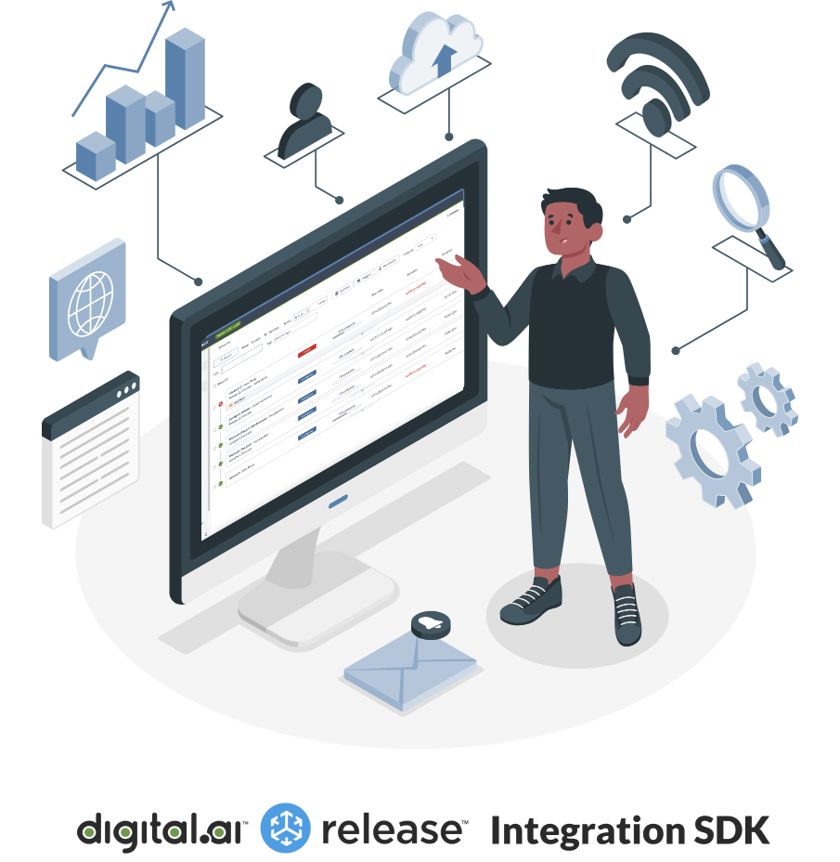

Welcome to the
Digital.ai Release Integration SDK Workshop
Notes:
Welcome everybody to the Digital.ai Release Integration SDK Workshop.
Today you will learn how to create and run new tasks for Digital.ai Release, using Python 3 and containers.
Thank you all for joining.
We're really proud to present you the new way to build the integration tasks in Release.

Slide 2
Workshop Agenda
Introduction
Part 1 – Hello World!
Part 2 – Create your own task
Part 3 – Connect to Kubernetes (optional)
Notes:
I'll do a quick introduction of what the SDK is all about and how the architecture hangs together.
And then it's off to do the workshop, where you will do the work. This is hands-on workshop.
The workshop is in three parts. We did a pre-run of the workshop and it turns out that the average time to complete each part is around an hour and a half. So don’t worry if you can’t finish it now, it would be great if you make it into part 2. You can do the remaining exercises offline and we will available for chat to help you later.
Part One is to get it up and running where you don't need to do any coding, but you get a sample project with a development environment and you're taught how to launch that and run a plugin. This is more of a tutorial style but you will do some coding at the end.
Part 2 will be more hands on where you will actually design an integration task to AWS.
In this part there is less guidance and you do need to figure things out yourself to tackle the assignment.
Part 3, which is optional, shows how you can connect Release to Kubernetes for a production setup. I wouldn't want recommend this if you haven't touched Kubernetes before. But if you have, it's a nice way to show how you can relatively easily install that component that's needed.

Slide 3
Limitations of current plugin model
Outdated version of Python (2.7)
Difficult to add third-party libraries
No support for other languages
No well-defined develop-test-deploy cycle
Installing plugins is cumbersome
Notes:
OK, now why did we build a new SDK? Well, if you have built a plugin before in Release, you've probably run into some limitations.
For one, we're using an outdated version of Python, Python 2.7 on the Java Virtual Machine, and unfortunately we're kind of stuck there.
We don’t have support for other languages. We have lots of requests with. Hey, can't you do Pearl or go or whatever, it's only Python.
It also difficult to add third party libraries.
Which is a shame because you use the integration plugins to integrate with some external system. So you need those libraries.
We also lack a clear process around unit testing and CI/CD.
And finally, installing plugins is quite cumbersome.

Slide 4
What’s new?
Integration plugins can be containers
Run outside of JVM process
Process isolation
Network isolation
Scalable
Use any language or framework
SDK for Python 3
Works like any other task in Release
The Digital.ai Release Integration SDK is in Tech Preview in 23.1
Notes:
So we completely rethought the way to build and run plugins and we came up with executing tasks as Docker containers.
And that's what we've been doing for the last year.
The integration task can now run outside of the JVM process of Release. We have process isolation. We have network isolation, and it's also more scalable.
It also means that we're not bound to the old Python 2.7 that's integrated into the JVM, but we can use any language or framework.
With the 23.1 release, that came out this week, we provide an SDK for Python 3. A software development kit that gives you, the developer the tools you need to write your plugins, and that's what we will be doing today.
So it's not only the technical plumbing, it's also the tools to make that a good experience.
And finally, one of the main requirements was that it would work like any other task in release. So if you look at it from the UI or modeling templates perspective, there's no difference between old tasks and new tasks. The container tasks behave the same and you can mix and match traditional tasks and container tasks.
The feature is still in Tech Preview.
Why is that?
First of all, we want to be able to incorporate your feedback.
And secondly, there are some things that we still want to solve.
One thing I mentioned is that installation is cumbersome, you need to restart the server. We will tackle that one for the next release in October, then you will be able to install plugins without restarts!
Another thing is that from UI perspective we didn’t change a lot and we want to give more insight of what is running where since the tasks run outside of Release now.

Slide 5
Digital.ai Release – Current plugin architecture
Digital.ai Release
Task
Task
Task
JVM
Notes:
I'll talk a little bit about the architecture.
This is the traditional architecture from previous versions
We have Digital.ai Release running as a Java process in the JVM.
Any integration task or plugin that you develop will run as a process in that Java process. So it's all in the same box. That means that there are some limitations like the task need to be written in some way that the JVM understands.

Slide 6
Digital.ai Release SDK – Development environment
Digital.ai Release
tcp
Container task
Container task
Container task
JVM
Docker
Notes:
What we did now with the container-based tasks is that your task will execute as Docker containers.
There are two ways to execute this.
The first one is the Development Environment that you will be using in the workshop.
You have a Docker environment and within Docker you have the main release process running and any task that you build with the SDK is run as a separate process in the same Docker.
The Docker setup is for development only. It's a bit limited and not quite secure enough to run in production.

Slide 7
Digital.ai Release SDK – Production environment
Digital.ai Release
https
Remote Runner
Container task
Container task
Remote Runner
Container task
JVM
Kubernetes
Notes:
So in production, we'll have a Kubernetes set up.
The Digital.ai Release process is in a JVM that can run either inside or outside of Kubernetes.
And it communicates with the Kubernetes cluster through a component called the Remote Runner. This is an agent that provides the communication between the main release process and the container. Tasks will execute as Kubernetes pods.
The Remote Runner is the coordinator for that.
One thing that you'll note here is that the remote runner has a single arrow pointing to Release, meaning that the Release server itself doesn't know how to reach into Kubernetes so the communication is from Kubernetes into into Release. This was done with the idea that the Kubernetes cluster can run on a different network.
There can be multiple Remote Runners. They do not need to be in the same Kubernetes cluster or network.

Slide 8
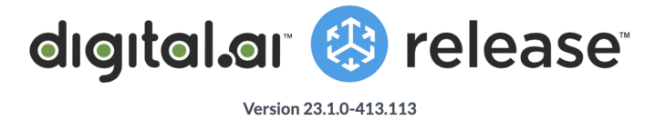



release
Digital.ai Release Integration SDK Workshop
May 11, 2023​
Register Now
18:30 IST – 15:00 CEST – 9 AM ET​ / Duration: 2 hours
Remote workshop for Digital.ai Release customers
Build new integrations in an instant! ​
To make your job easier, we are bringing a brand-new integration SDK experience^{(*)} that gets you up and running in a matter of minutes.
Run tasks as containers, using any language or third-party library.
Join Hes Siemelink, our Principal Product Manager, as he shares the details on using the new SDK.
In this workshop, you will learn how to
Build and maintain custom integrations using Python 3
Set up a development environment ​for building, testing, installing, and running integration tasks
Configure a production-style architecture to run the container-based tasks in a Kubernetes cluster
Register now on https://info.digital.ai/release-integration-sdk-workshop.html
^{(*)} The Digital.ai Release Integration SDK is available as Tech Preview in version 23.1

Slide 9
System Requirements
Some programming experience
OS: Windows / Linux / Macos
Admin privileges required
Macos Ventura required for M1/M2 macs
Memory: 16Gb ram or more
Git / GitHub account
Docker Desktop
Python 3.11
Notes:
You will be running the workshop on your own laptop.
You would need some programming experience. The workshop is in Python 3, but the coding is not that complicated
For the first part you don't need to do a lot in Python.
Operating system Windows, Linux, Mac OS. We had some trouble with M1M2 Max. They need to be in the latest version.

Slide 10
What the SDK is about
import unittest from src.jenkins_tasks import DevOpsJenkins
class TestJenkins(unittest.TestCase): def test_build(self): # Given task = DevOpsJenkins() task.input_properties = { 'url': 'http://localhost:8080', 'username': 'admin', 'password': 'admin' } # When task.execute_task() # Then self.assertEqual(task.get_output_properties()['response'], 'SUCCESS')
Notes:
Final slide, what I like a lot about the SDK.
What is it about?
The idea is that you have to write minimal code to write a plugin and the SDK provides you all the tools and infrastructure to make that happen.
What I'm showing you here is not a task itself. The actual implementation is somewhere else.
This is a unit test.
I wanted to highlight this because this is in the end how you will test your task and it's really
that simple, and that's what I love about it.
In this case, you create a Jenkins task, give it input properties like you would do in the UI. You run the task and then you check the output.
That's all there is to it.
That's all there should be to it. There is not a lot of boilerplating. Now you can run it as a unit test and sometimes it finishes so fast the console says it was completed in 0.000 seconds.
So this is the goal of the SDK.
To move all the complicated stuff out of the way so you can focus on on what's really important: the business logic of your task.

Slide 11
Let’s create a plugin!
Go to https://github.com/digital-ai/release-integration-sdk-workshop
Notes:
That’s the end of the presentation. Now let's create a plugin!
The workshop is mostly self-guided, so you have to go to this URL. If somebody can post it in the chat
You can work on it and we'll leave the channel open for questions, either live or on the Teams chat.
We have a lot of people on the call, and we’re here from Digital.ai to help you if you get stuck.
If there are a lot of people asking questions and gets a bit crowded, we'll create a breakout room.
So the point of the workshop is to have an assisted self-guided environment.
And with that, I invite you all to to get started!

